Slide 1

Performance Evaluation of a cellular system
Barbieri Giovanni
Salti Nicolò
Trasacco Andrea
A.Y. 2022/2023

Slide 2







SYSTEM Overview
RRH
+
Cell
s
AS
BBU
RRH
+
Cell
t
RRH
+
Cell
t: interrarival time of packets
s: packet size
X: compression ratio
S: compression time $(X×70ms)$
C: interface speed (byte/s)
CU
Interface

Slide 3
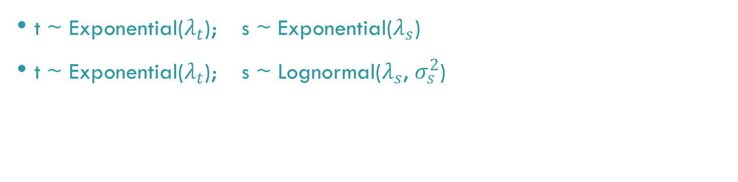
OBJECTIVE and kpi
Objective: the assessment of the most convenient level of compression, depending on the load, to reach the maximum performance of the system.
KPI: end-to-end delay
SCENARIOS
t ~ Exponential($λ_{t}$); s ~ Exponential($λ_{s}$)
t ~ Exponential($λ_{t}$); s ~ Lognormal($λ_{s}$, $σ_{s}^{2}$)

Slide 4
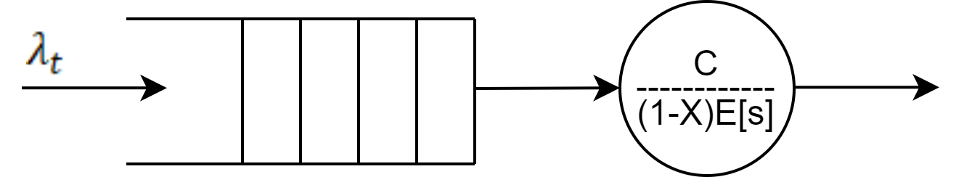

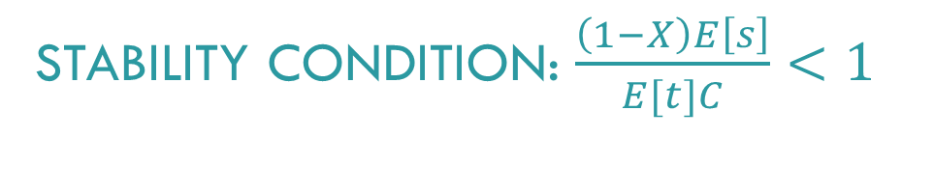
MODEL $(X = 0)$
No compression → CU is immaterial
Exponential scenario → M/M/1
Lognormal scenario → M/Lognormal/1
INTERFACE
STABILITY CONDITION: $\frac{\left(1−X\right)E\left[s\right]}{E[t]C}<1$

Slide 5
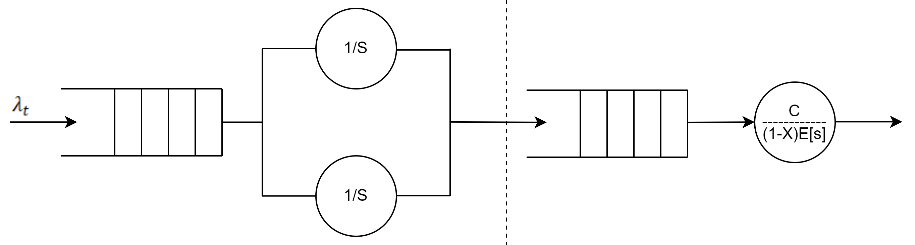


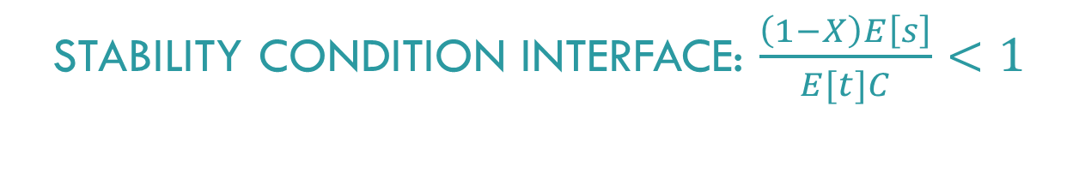
COMPRESSION UNIT
INTERFACE
MODEL $(X≠0)$
Compression Unit → M/D/2
Interface (Exponential scenario) → G/M/1
Interface (Lognormal scenario) → G/Lognormal/1
STABILITY CONDITION CU: $\frac{S}{2E[t]}<1$
STABILITY CONDITION INTERFACE: $\frac{\left(1−X\right)E\left[s\right]}{E[t]C}<1$

Slide 6
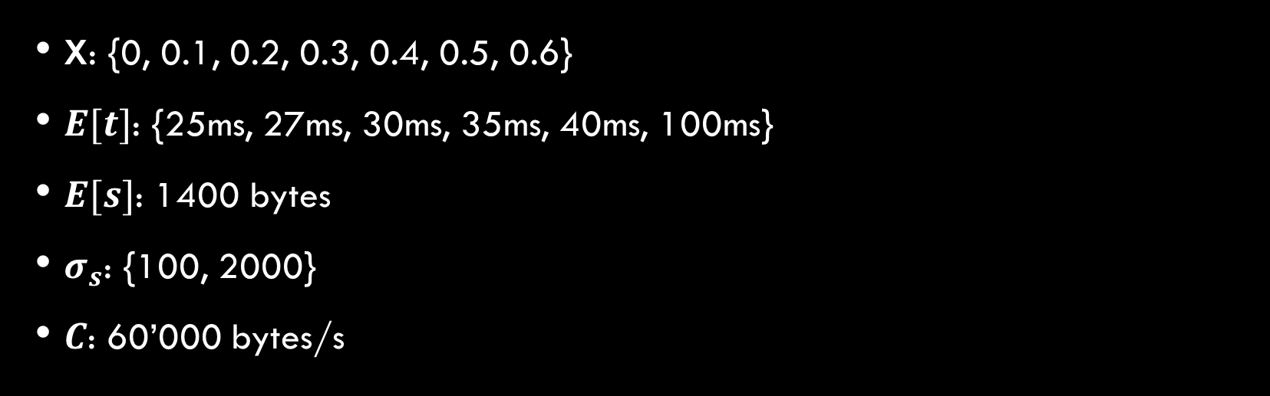
IMPLEMENTATION aND VERIFICATION
OMNeT++ 6.0
Tested the correctness of the code, considering the borderline cases
CALIBRATION OF FACTORS AND PARAMETERS
X: {0, 0.1, 0.2, 0.3, 0.4, 0.5, 0.6}
$E[t]$: {25ms, 27ms, 30ms, 35ms, 40ms, 100ms}
$E[s]$: 1400 bytes
$σ_{s}$: {100, 2000}
$C$: 60’000 bytes/s

Slide 7
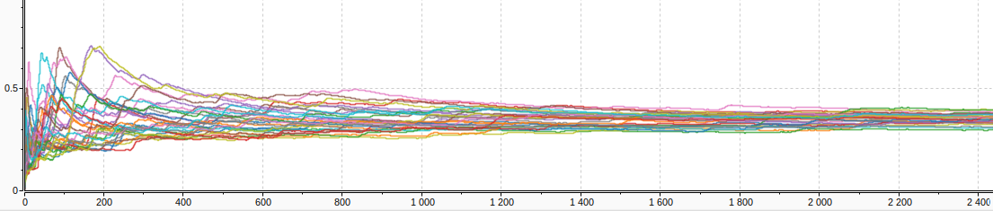
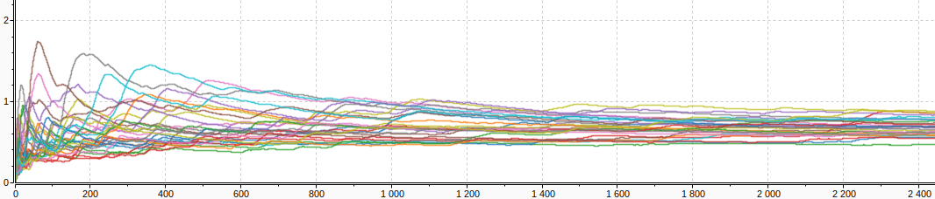
WARM-UP AND SIMULATION TIMES
Moving average End-to-end delay exponential scenario
Moving average End-to-end delay lognormal scenario 𝜎𝑠=2000
Simulation time: 1800 sec
Warm-up time: 1200 sec

Slide 8
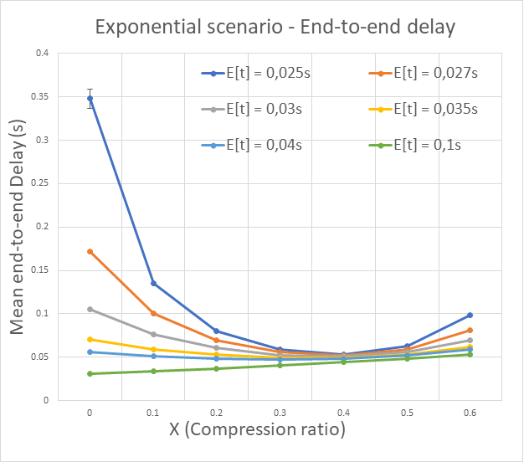

SIMULATION – EXPONENTIAL SCENARIO
$E\left[t\right]< 40ms$ → $X=40\%$
$E\left[t\right]> 40ms$→ $X = 0\%$
Threshold: 40ms

Slide 9
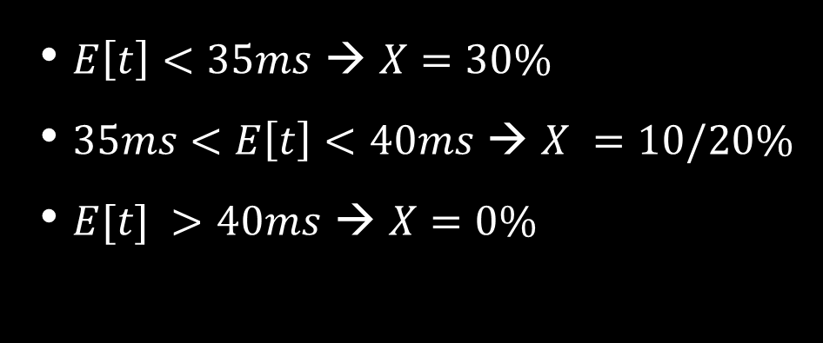
SIMULATION – LOGNORMAL SCENARIO
$E\left[t\right]<35ms$ → $X=30\%$
$35ms<E\left[t\right]<40ms$ → $X =10/20\%$
$E[t] >40ms$ → $X=0\%$

Slide 10
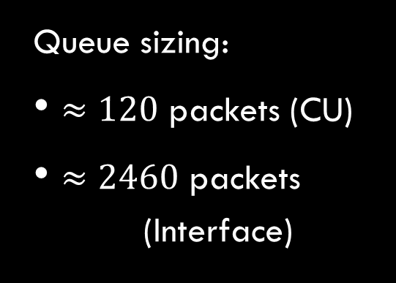
SIMULATION – LOGNORMAL SCENARIO
Queue sizing:
$≈120$ packets (CU)
$≈2460$ packets (Interface)

Slide 11
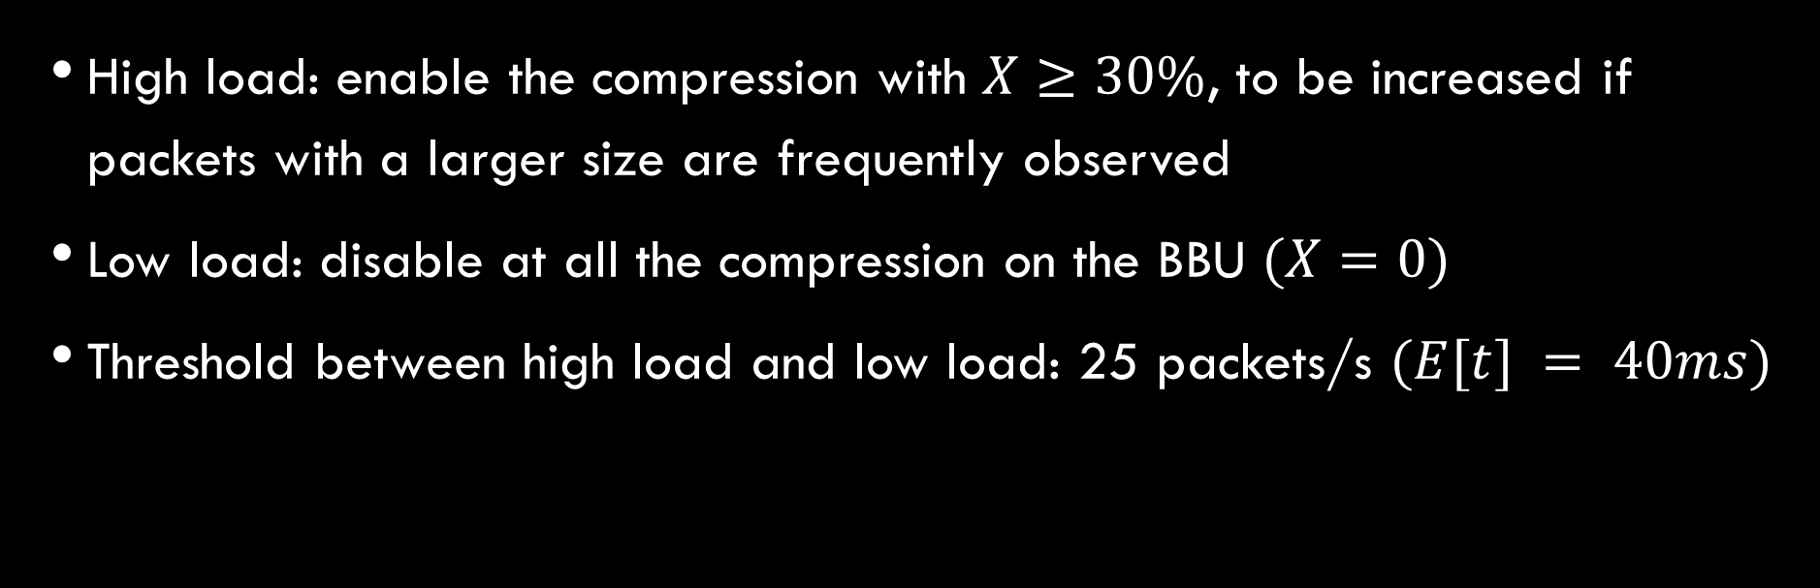
CONCLUSIONS
High load: enable the compression with $X≥30\%$, to be increased if packets with a larger size are frequently observed
Low load: disable at all the compression on the BBU $(X=0)$
Threshold between high load and low load: 25 packets/s $(E[t] = 40ms)$

